Slide 1

HEALTH APP
Team Members:
Mohan Krishna AlAvala
HARISH THADKA
BHARATH KRISHNA GANDHASIRI
Tejaswi Reddy Kandula
ROHITHA REDDY MEDA

Slide 2
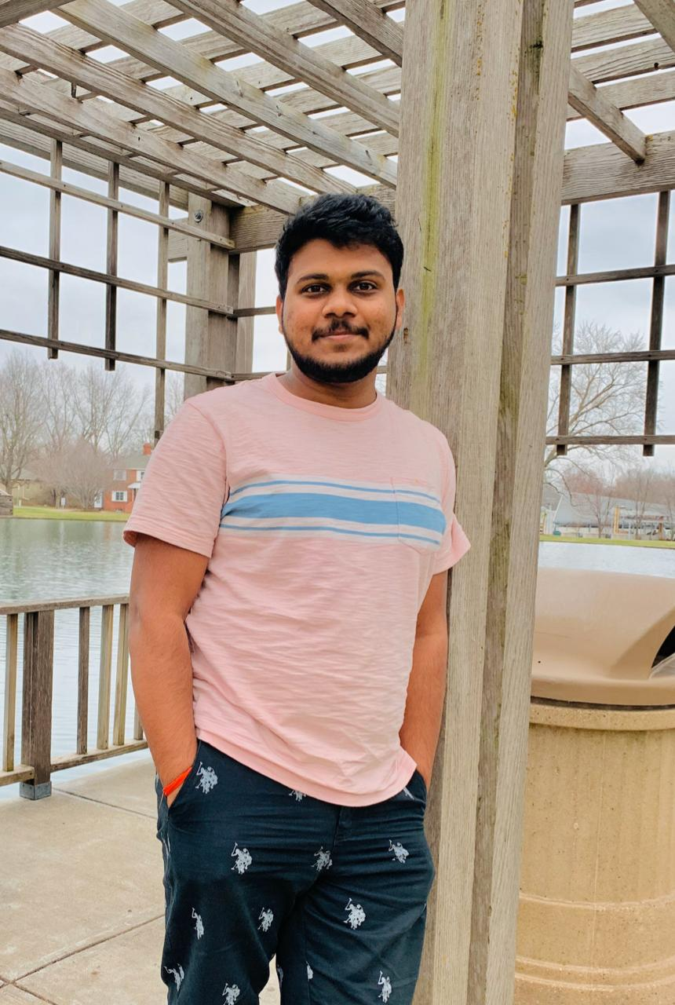
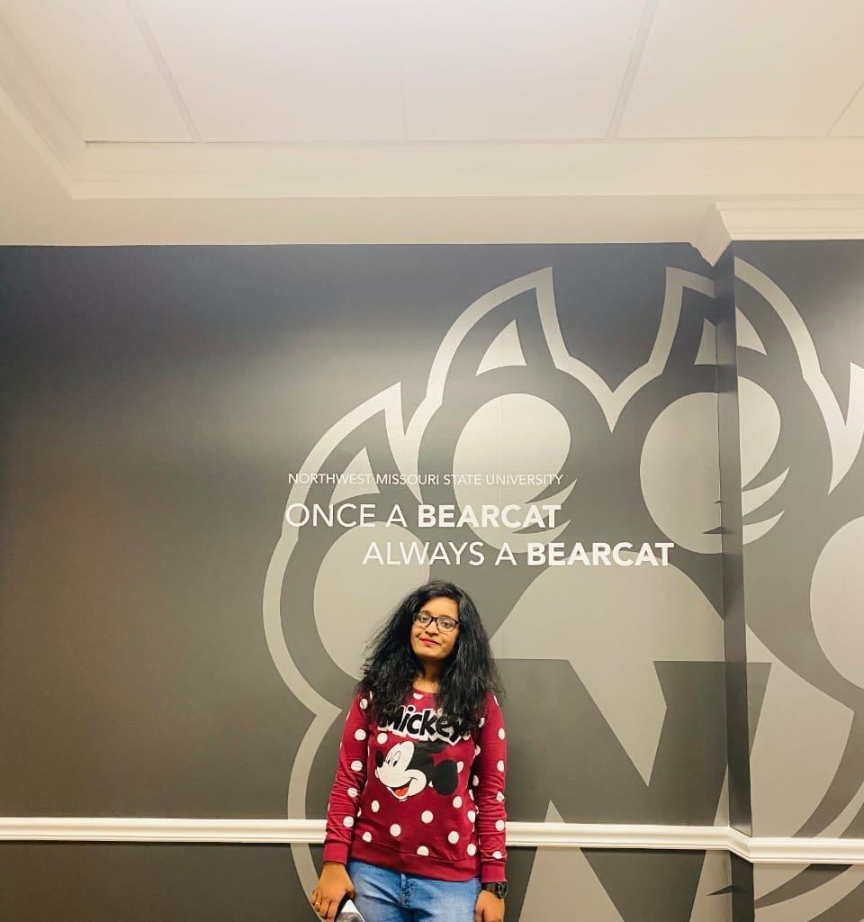
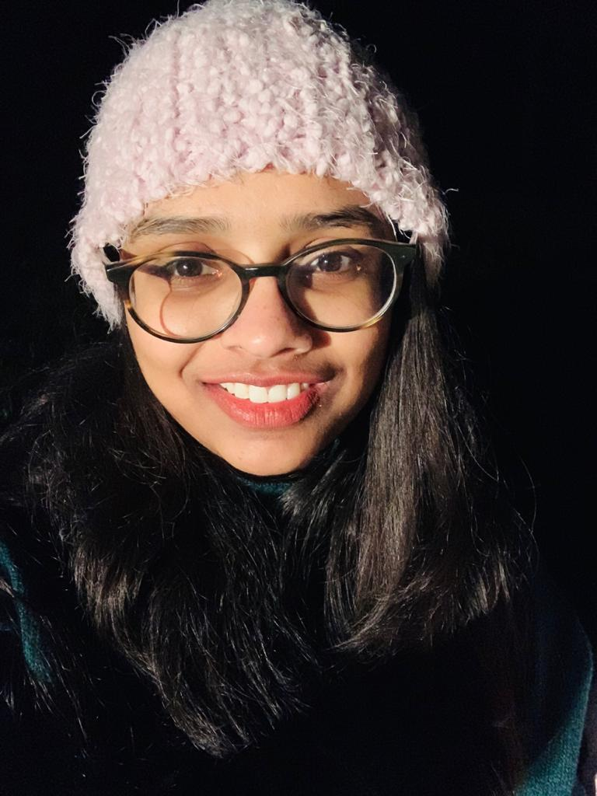
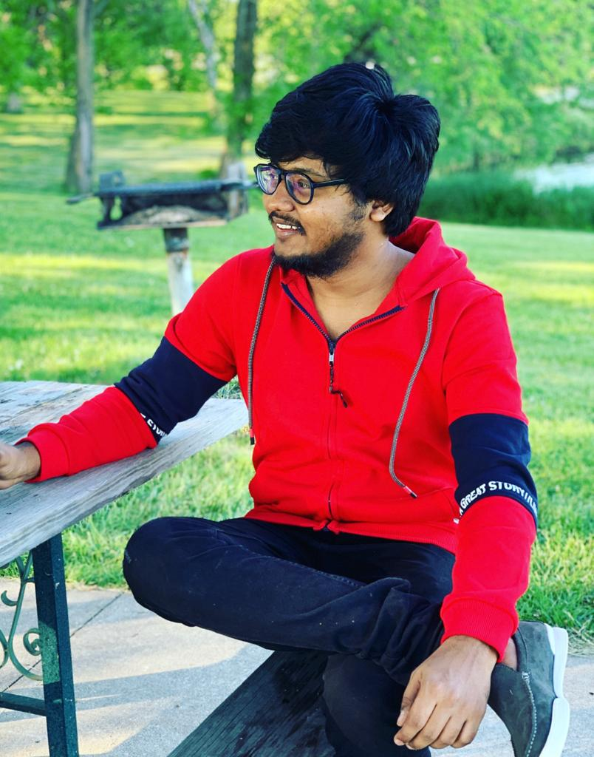
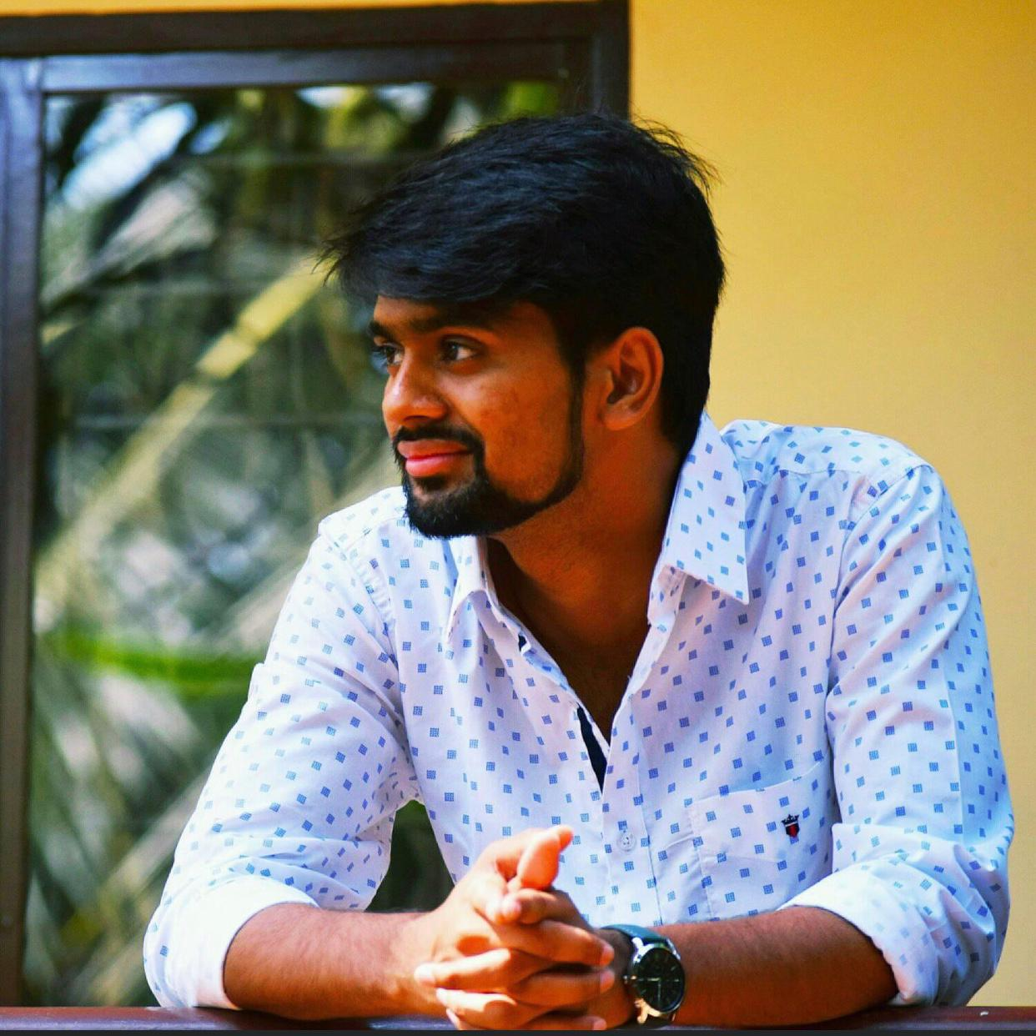
HEALTH APP DEVELOPMENT TEAM
Mohan Krishna
Team Lead
Tejaswi Reddy
Full Stack Developer
Rohitha Reddy
Database Engineer
Bharath Kumar
Front end Developer
Harish Thadka
Project Manager

Slide 3
OVERVIEW
The main purpose of this health app is to keep track on the user health history.
HEALTH HISTORY BASED ON daily step count done by the user, number of hours slept, amount of water consumed in litres , amount of food consumed(Kcal) in the form of fruits and vegetables.
This app also keeps track on the monthly activity of the user on the options provided in the app.
It also shows the daily exercise activity. User can create challenges or join the present challenge.
This app can BE devEloped by 5 devELopers.

Slide 4
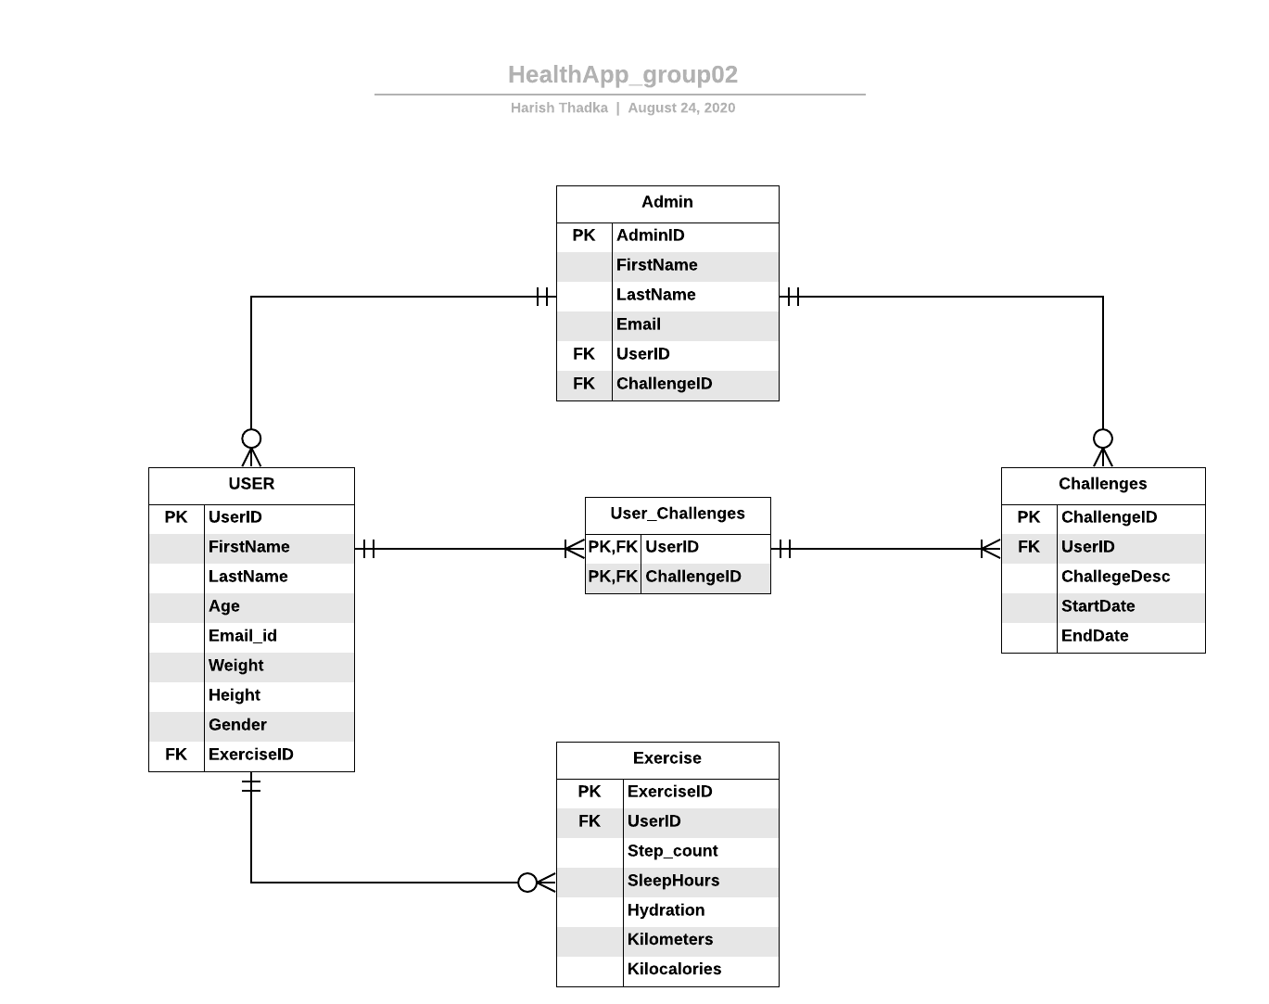
ER DIAGRAM

Slide 5
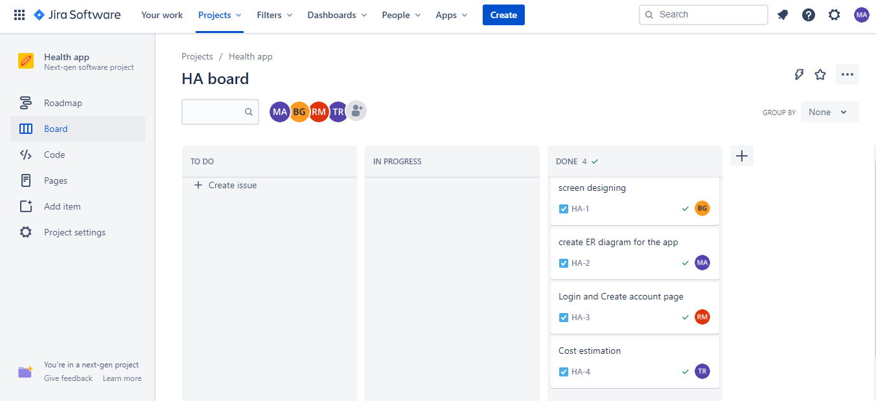
JIRA DASHBOARD

Slide 6
USER ROLES
As a user, I'll create my profile in the app.
As a user, I want to login to the app.
As a user, if I forget the password I can create new password by clicking on "Forget Password".
As a User, I can modify my personal Information by clicking on "ME“.
As a User, I can create my own challenges or can join the existing challenge.
As a User, I can view data from the previous challenges.
As a admin, I can manage users and challenges.

Slide 7
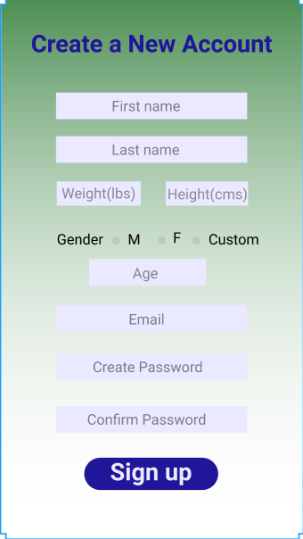
Proposed Screens
USER SIGNUP

Slide 8
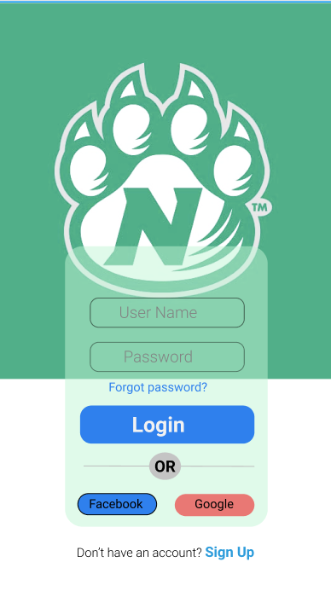
USER LOGIN

Slide 9
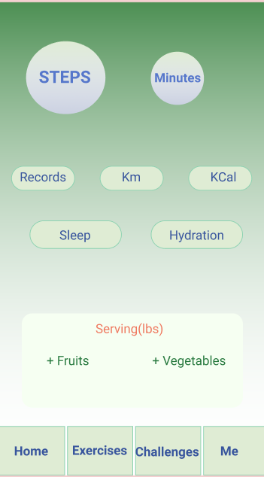
HOME SCREEN

Slide 10
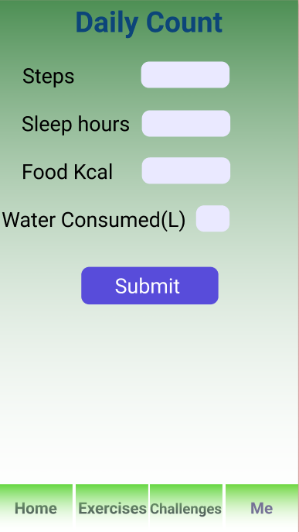
DAILY COUNT

Slide 11
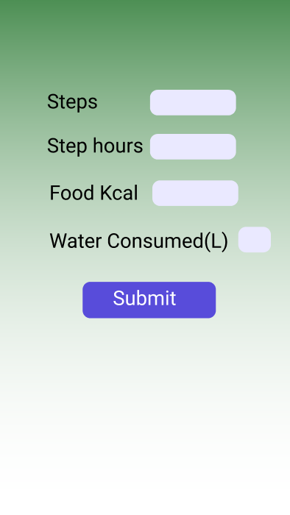
ACTIVITY

Slide 12
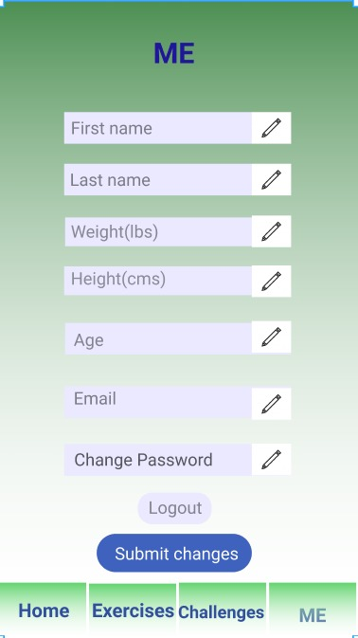
USER DETAILS

Slide 13
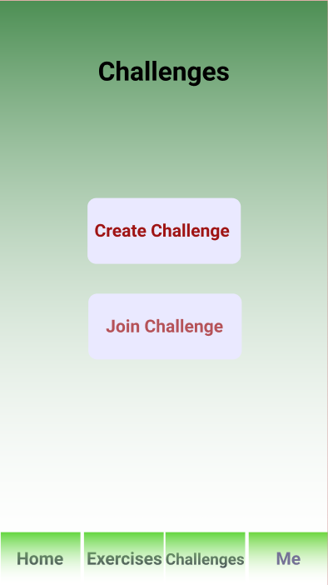
CHALLENGES

Slide 14
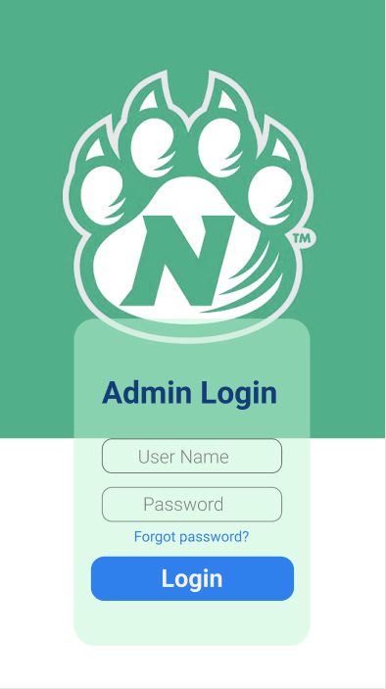
ADMIN LOGIN

Slide 15
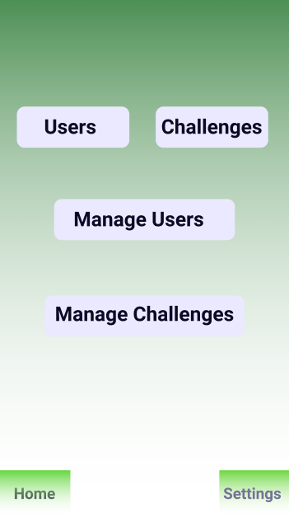
ADMIN HOME

Slide 16
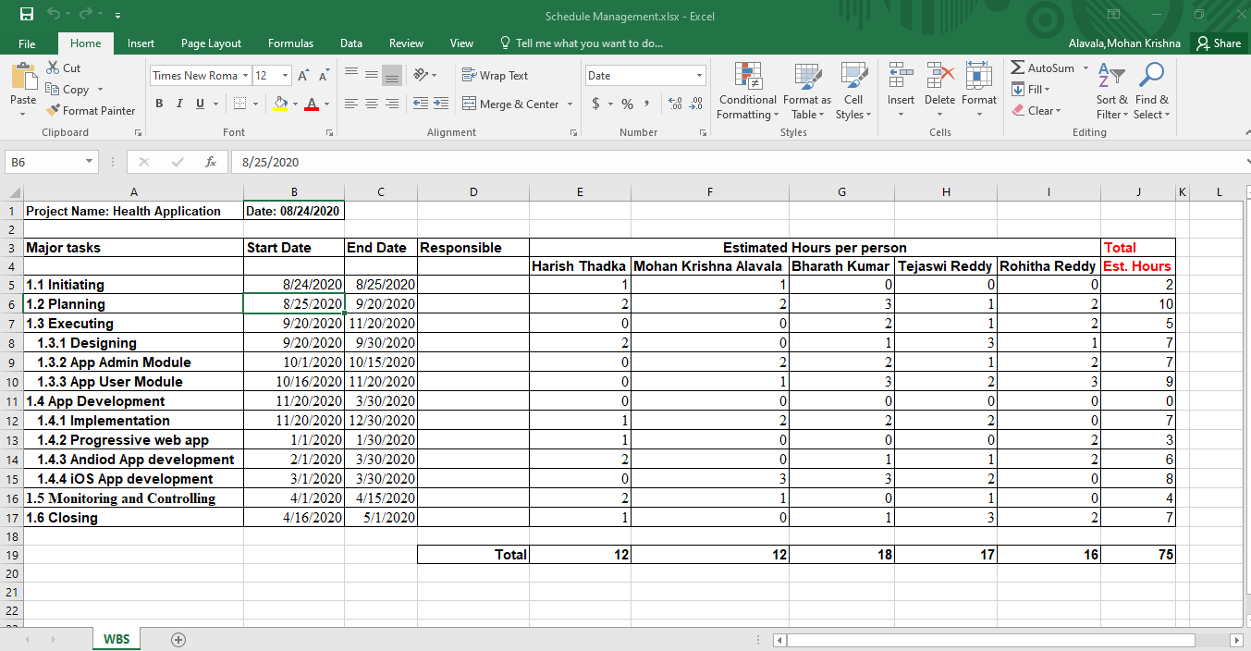
SCHEDULE MANAGEMENt

Slide 17
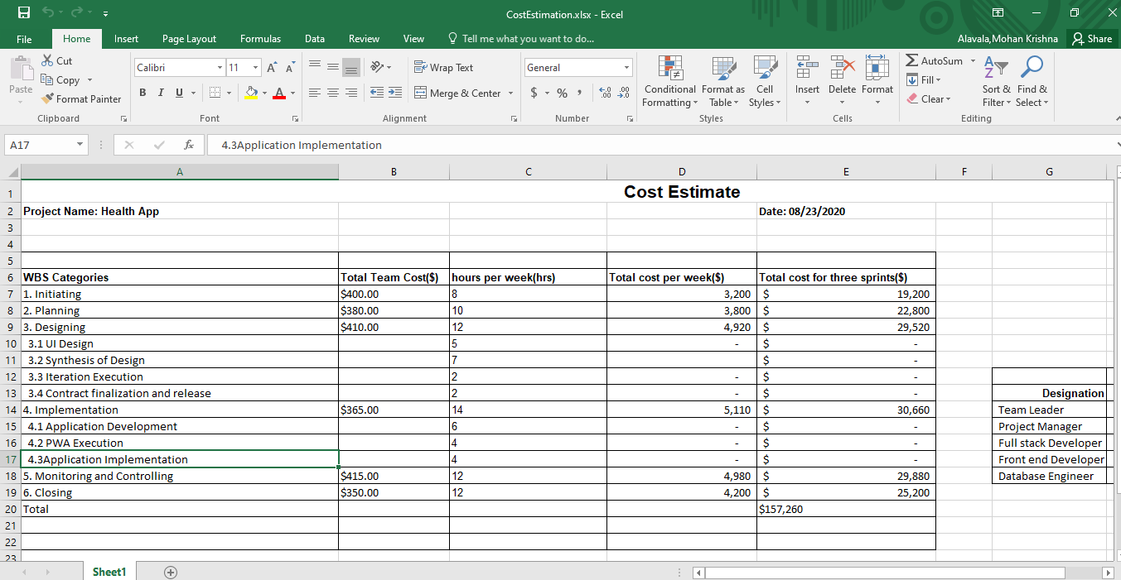
COST ESTIMation

Slide 18
THANK YOU
Any Queries Feel Free to Ask

